Slide 1

Pointers
Prof Somesh Nandi
Department of AIML -RVCE

Slide 2
Introduction to Pointers
The pointers in C language refer to the variables that hold the addresses of different variables of similar data types
These variables could be of any type- char, int, function, array, or other pointers.
Let us look at an example where we define a pointer storing an integer’s address in a program.
int x = 10;
int* p = &x;
Here, the variable p is of pointer type, and it is pointing towards the address of the x variable, which is of the integer type

Slide 3
Declaration of a Pointer
The declaration of a pointer would take a form like this: data_type * name_of_pointer_variable;
Note that here,
The data_type refers to this pointer’s base type in the variable of C. It indicates which type of variable is the pointer pointing to in the code.
The asterisk ( * ) is used to declare a pointer. It is an indirection operator, and it is the same asterisk that we use in multiplication.
Example
int *q; // a pointer q for int data type
char *x; // a pointer x for char data type

Slide 4
Initialization of a Pointer
Once we declare a pointer, we then initialise it just like the standard variables using an address of the variable.
In case we don’t initialise the pointers in any C program and start using it directly, the results can be pretty unpredictable and potentially disastrous.
We use the & (ampersand) operator to get the variable’s address in the program.
We place the & just before that variable’s name whose address we require. Here is the syntax that we use for the initialisation of a pointer,
Syntax of Pointer Initialization
pointer = &variable;

Slide 5
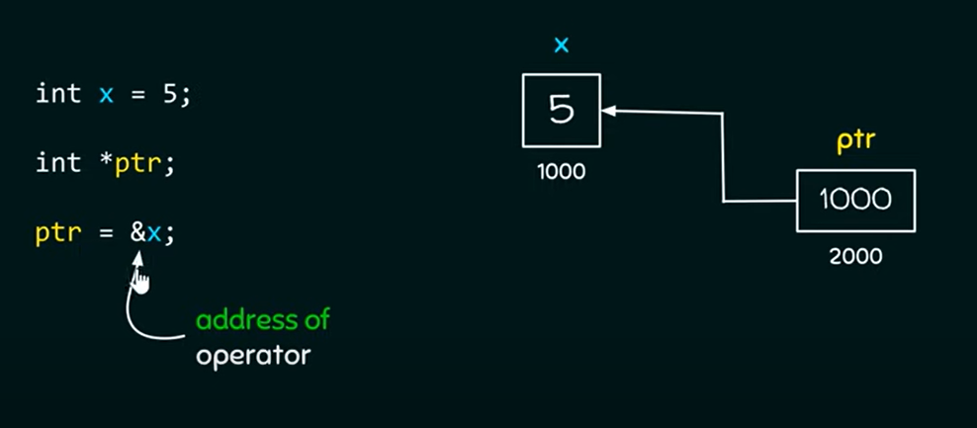
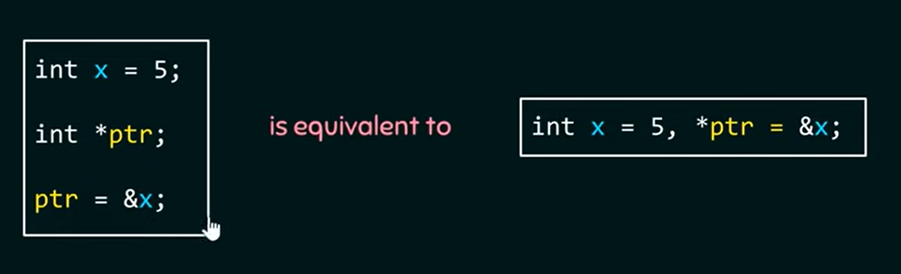
Initialization of a Pointer -Example

Slide 6
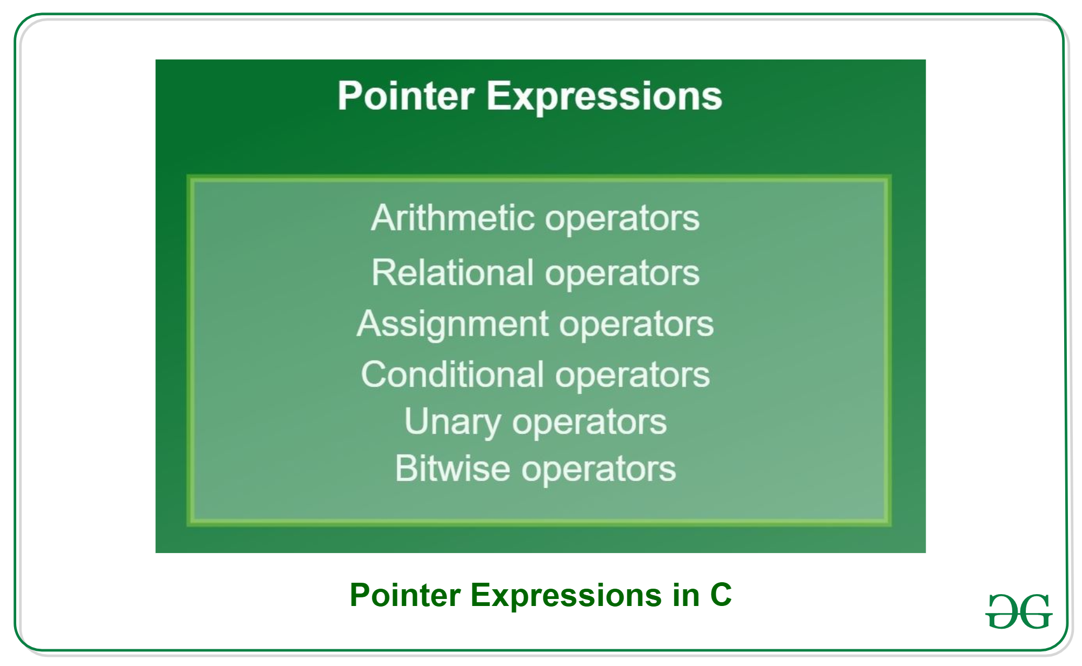
Pointers- Expressions

Slide 7
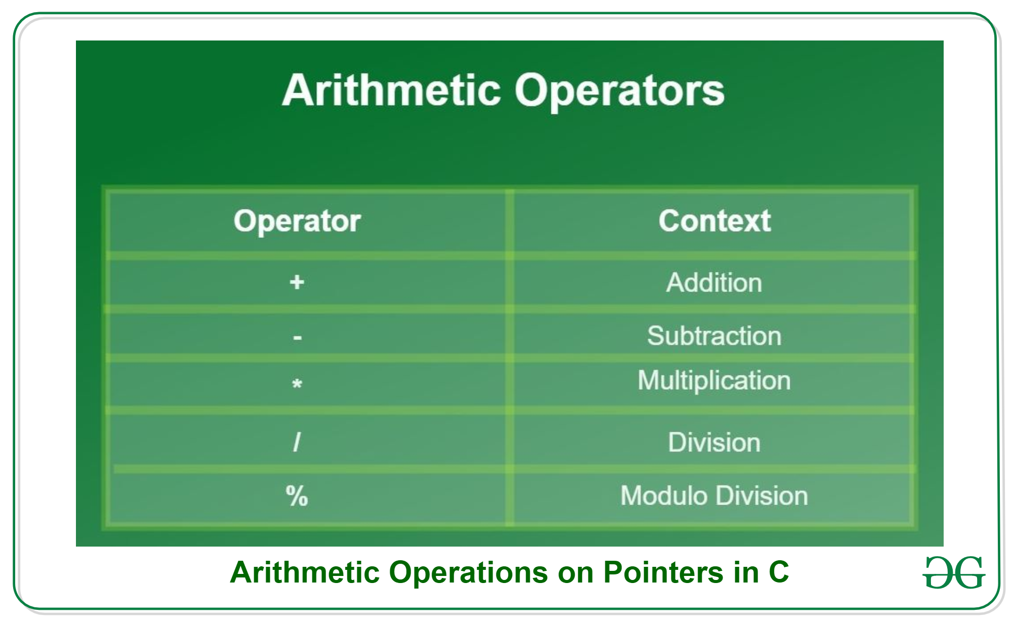
Arithmetic Operators

Slide 8
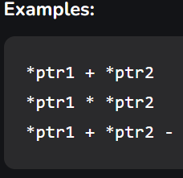
Arithmetic Operators

Slide 9
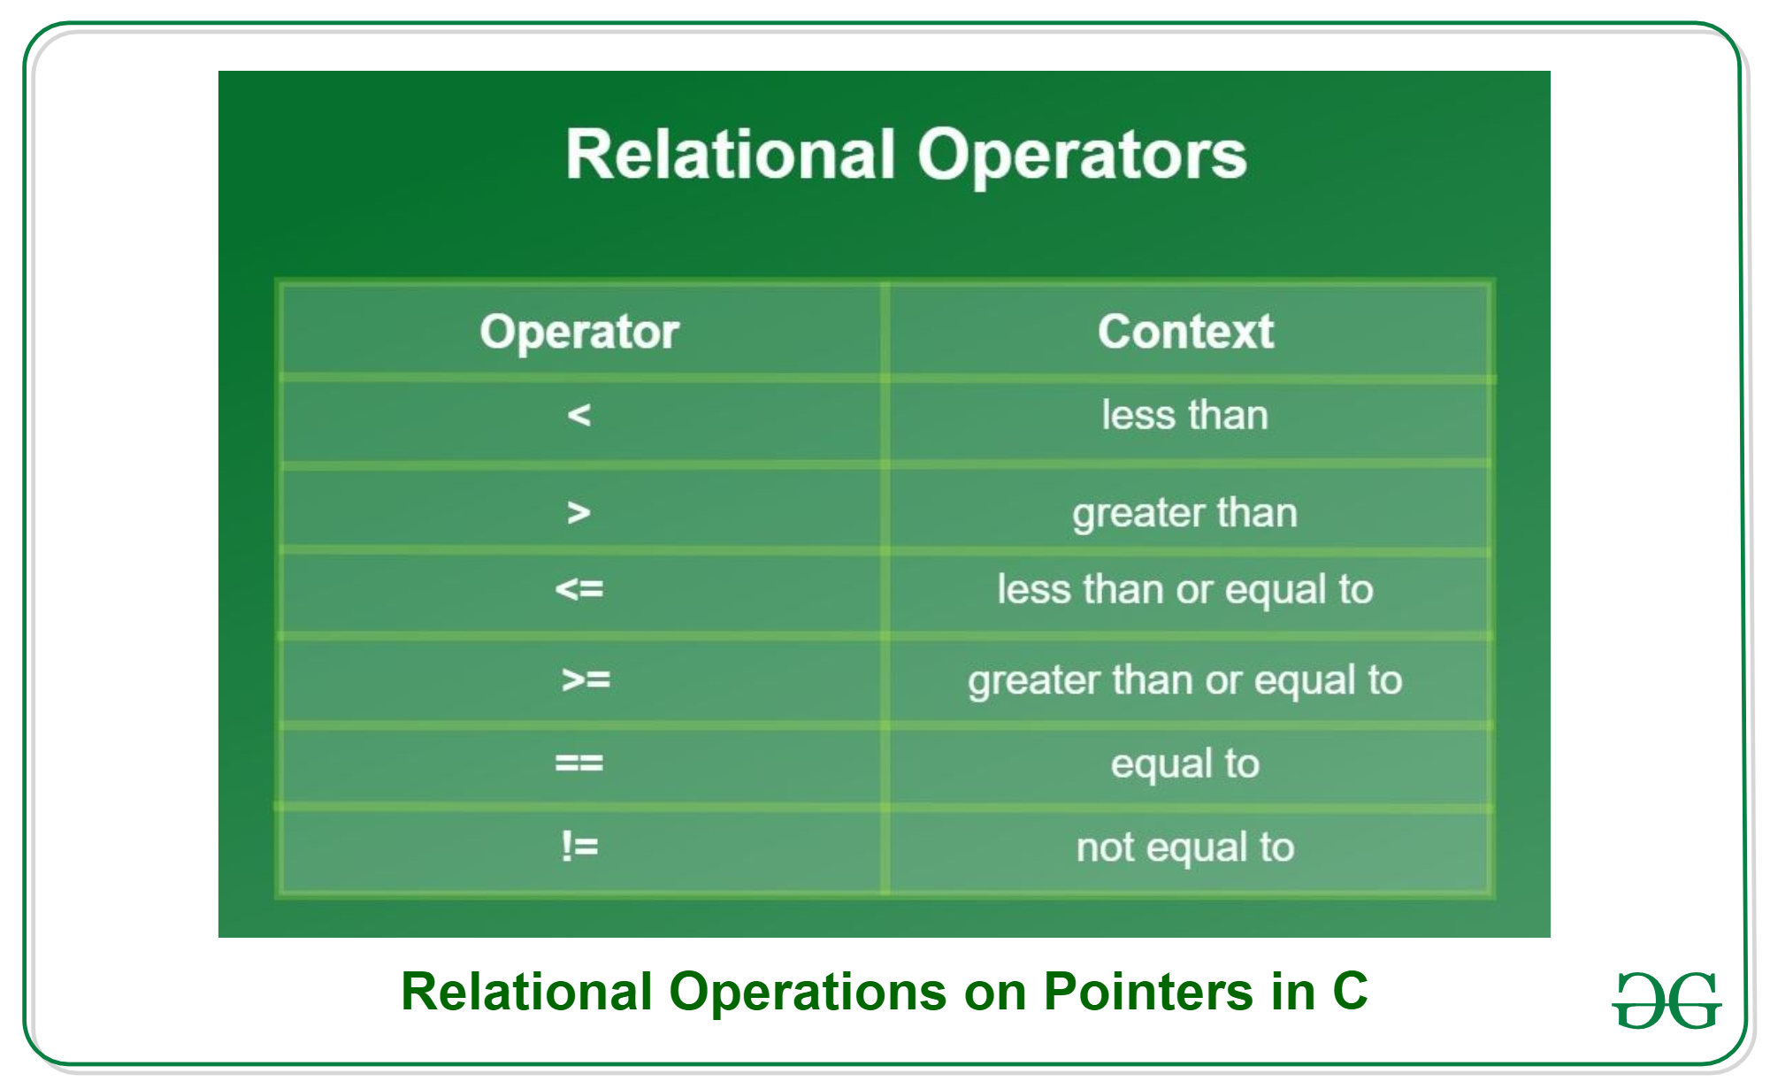
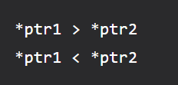
RELATIONAL OPERATORS
The value of the relational expression is either 0 or 1 that is false or true. The expression will return value 1 if the expression is true and it’ll return value 0 if false

Slide 10
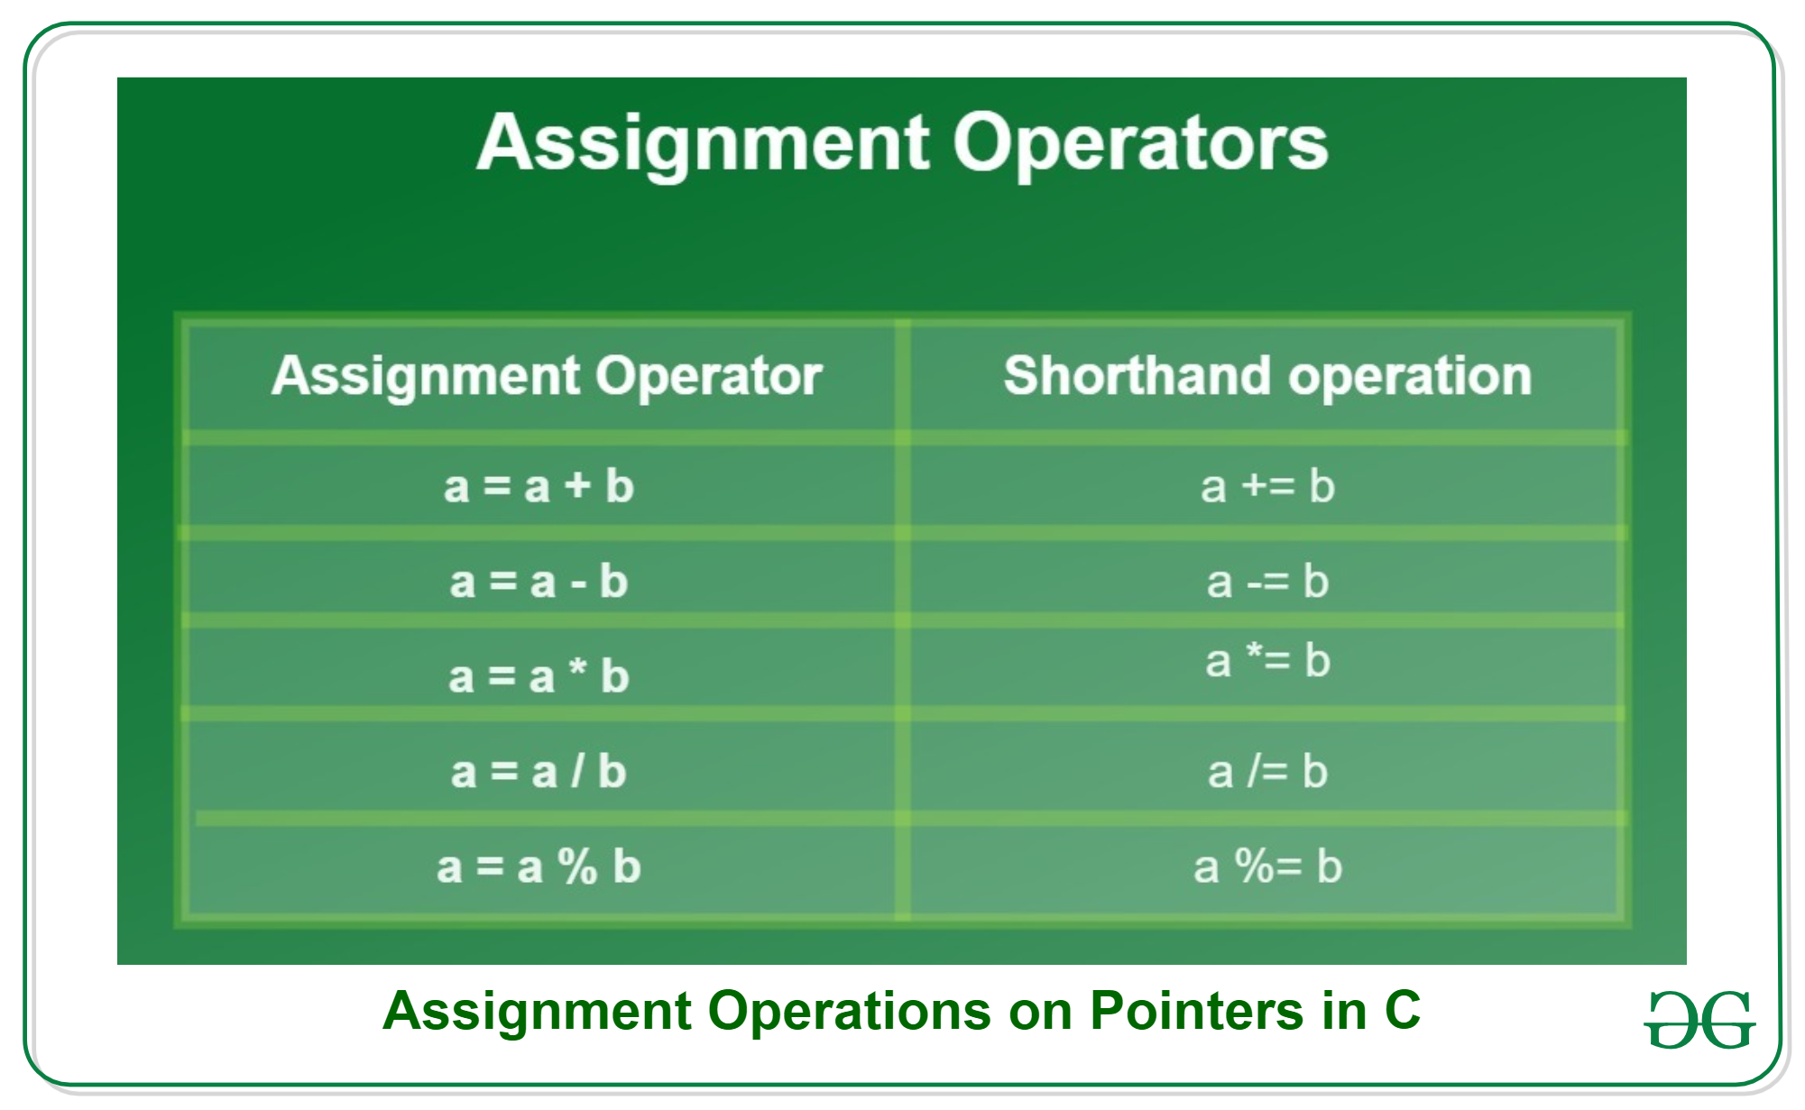
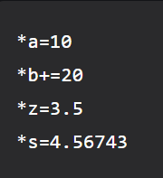
Assignment Operators

Slide 11
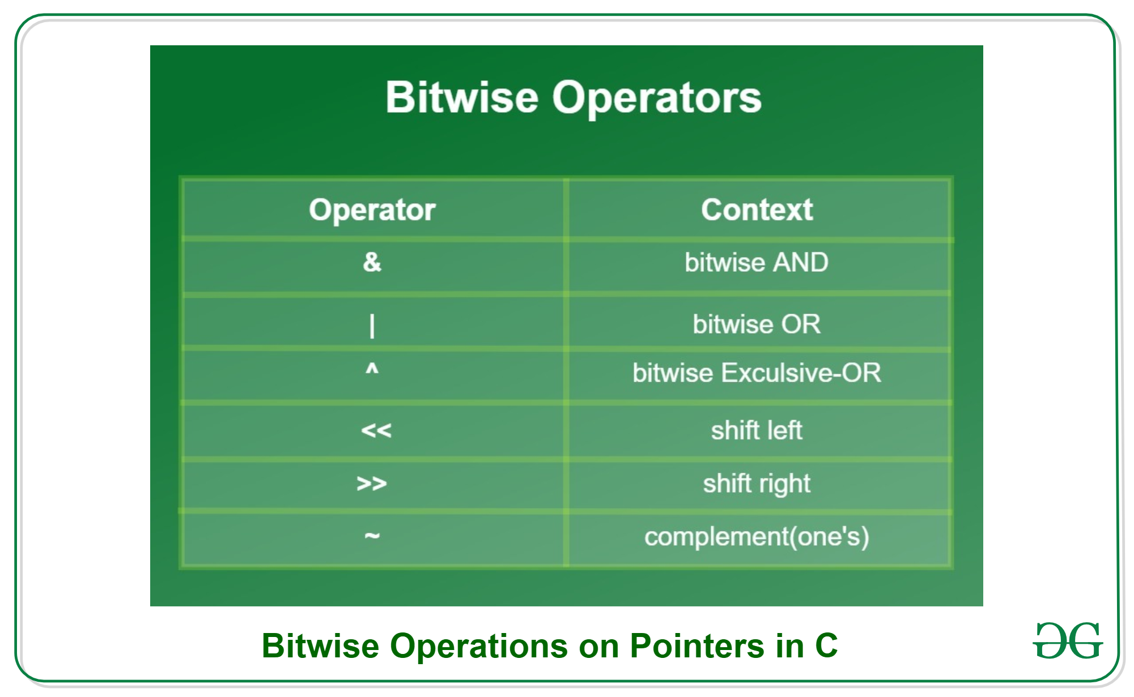
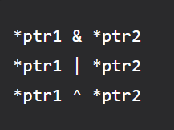
Bitwise Operators

Slide 12
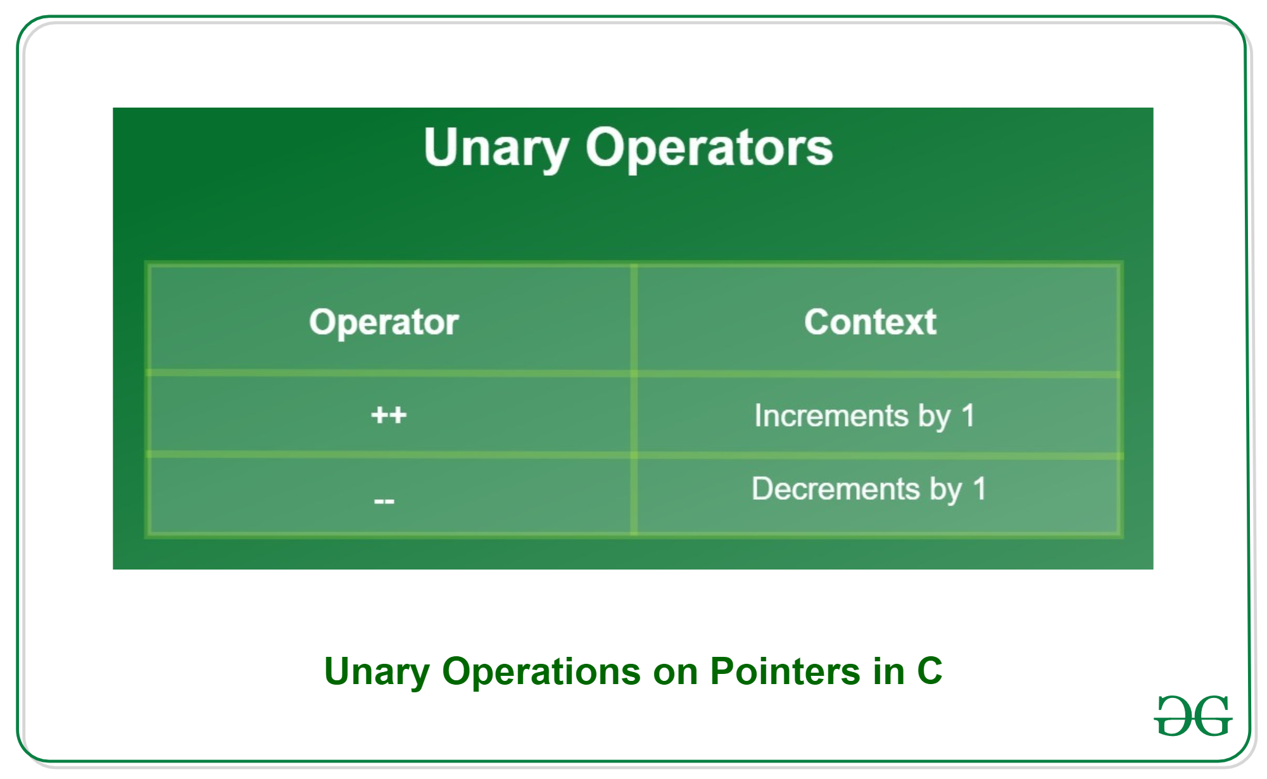
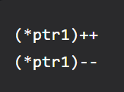
Unary Operators

Slide 13
Conditional Operators
There is only one mostly used conditional operator in C known as Ternary operator. Ternary operator first checks the expression and depending on its return value returns true or false, which triggers/selects another expression. Syntax:
expression1 ? expression2 : expression3;
Example:
c = (*ptr1 > *ptr2) ? *ptr1 : *ptr2;

Slide 14
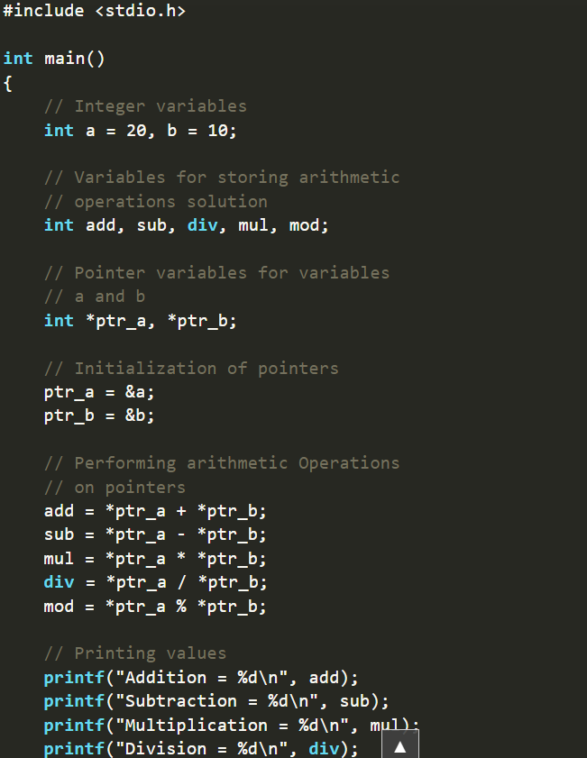
Example Program

Slide 15
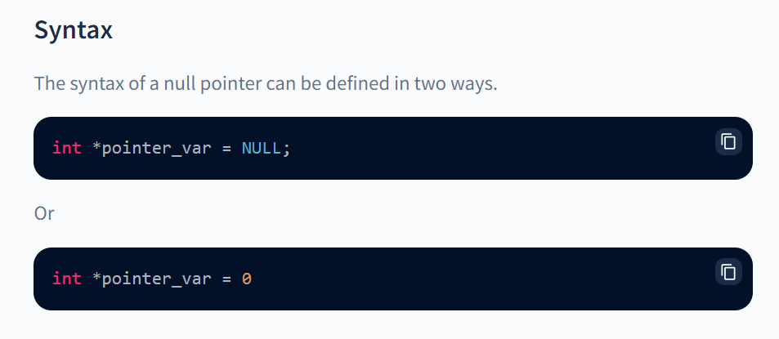
Null Pointer
Null pointer is a pointer that does not point to any memory location and hence does not hold the address of any variables.
Null indicates that the pointer is pointing to the first memory location. meaning that 0th location.

Slide 16
Use of Null Pointer
To initialize a pointer variable when it hasn't been assigned a proper memory address yet.
1
Before accessing any pointer variable, check for a null pointer. We can handle errors in pointer-related code this way, for example, only dereference a pointer variable if it is not NULL.
2
When we don't want to pass a valid memory address to a function argument, we can pass a null pointe
3

Slide 17
Pointers – Arithmetic
Pointer Arithmetic is the set of valid arithmetic operations that can be performed on pointers.
The pointer variables store the memory address of another variable. It doesn’t store any value.
These operations are:
Increment/Decrement of a Pointer
Addition of integer to a pointer
Subtraction of integer to a pointer

Slide 18
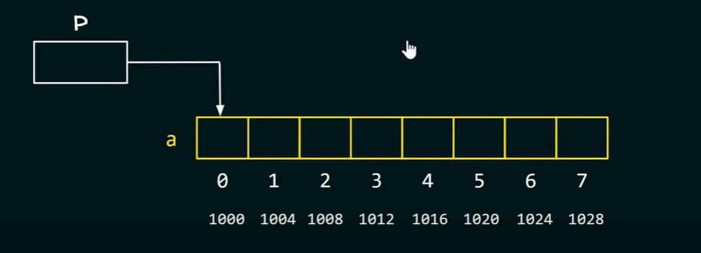
Pointer Arithmetic (Addition)
When a pointer is added with an integer value, the value is first multiplied by the size of the data type and then added to the pointer.
Let us consider the array given in fig
The code : p =&a[0]
Now if I want to move to third
Post p =p+3 = &a[0+3] = It will
Move to third post = i.e 1012
1000+(size of int)*3 =1012

Slide 19
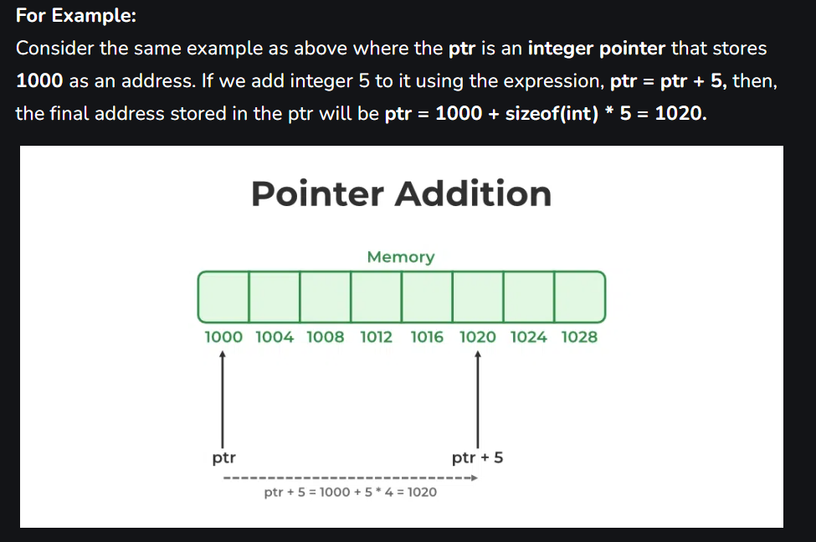
Pointer Arithmetic (Addition)-Example

Slide 20
Pointer Arithmetic - Increment and Decrement
Increment: It is a condition that also comes under addition. When a pointer is incremented, it actually increments by the number equal to the size of the data type for which it is a pointer.
Decrement: It is a condition that also comes under subtraction. When a pointer is decremented, it actually decrements by the number equal to the size of the data type for which it is a pointer.

Slide 21
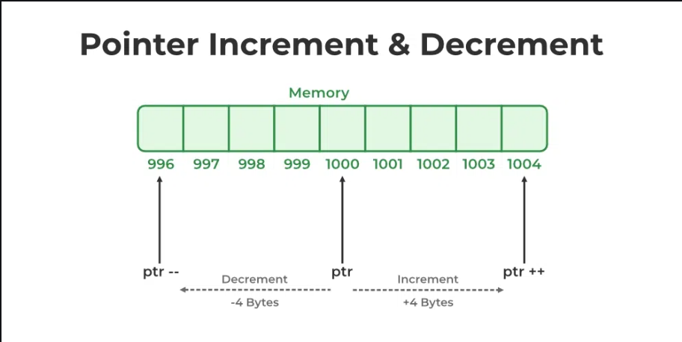
Pointer Arithmetic - Increment and Decrement -Example
If an integer pointer that stores address 1000 is incremented, then it will increment by 4(size of an int), and the new address will point to 1004. While if a float type pointer is incremented then it will increment by 4(size of a float) and the new address will be 1004.
Decremented - 996

Slide 22
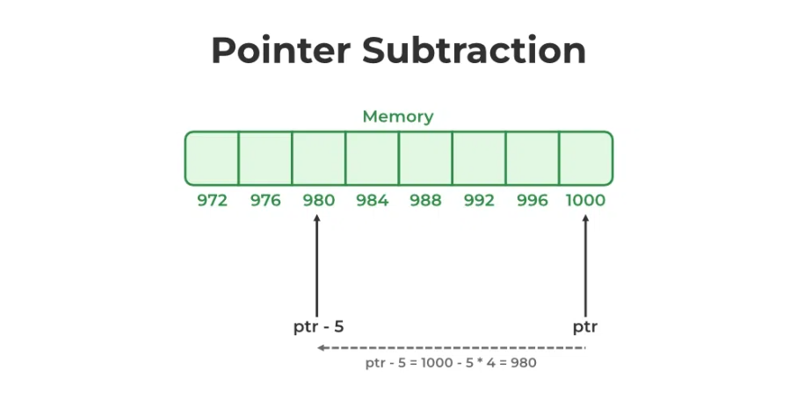
Pointer Arithmetic - Subtraction -Example
When a pointer is subtracted with an integer value, the value is first multiplied by the size of the data type and then subtracted from the pointer similar to addition.
For Example:
Consider the example where the ptr is an integer pointer that stores 1000 as an address. If we subtract integer 5 from it using the expression, ptr = ptr – 5, then, the final address stored in the ptr will be ptr = 1000 – sizeof(int) * 5 = 980.

Slide 23
Passing Parameters to Functions using Pointers
How to declare a function which accepts a pointer as an argument?
If a function wants to accept an address of an integer variable then the function declaration will be,
return_type function_name(int*);
If we change the argument value in the function, it will modify the actual value of a variable.

Slide 24
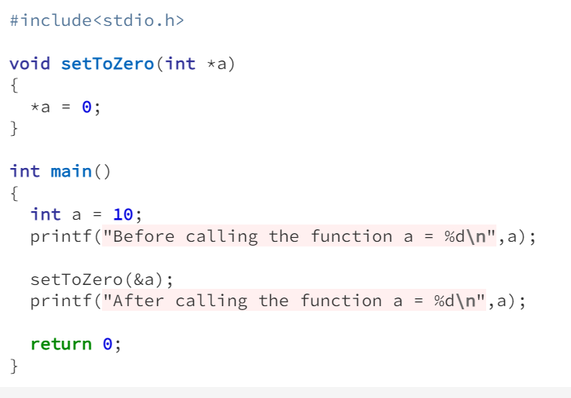
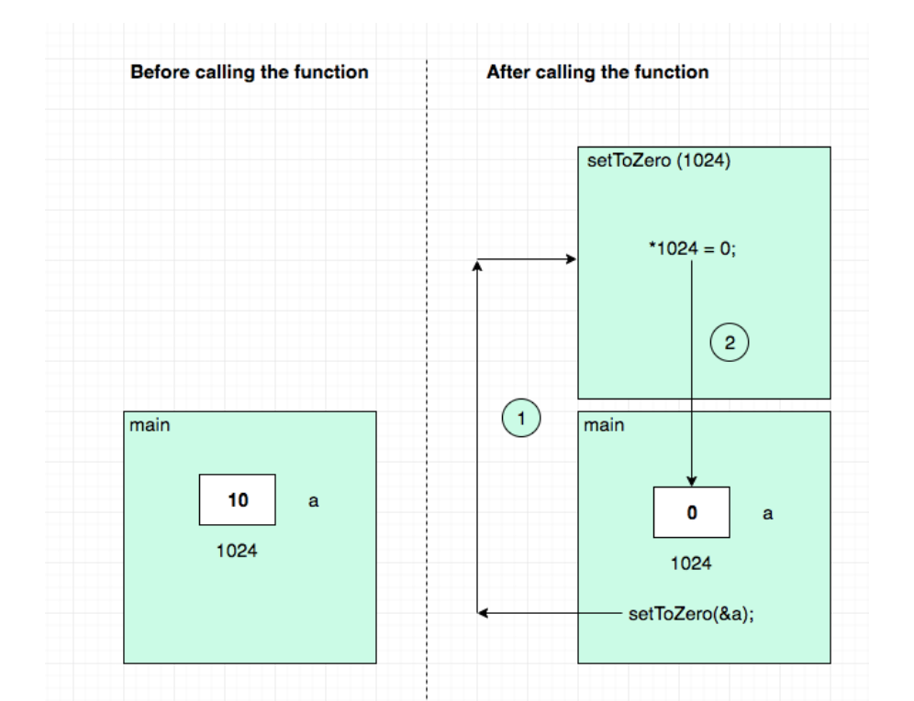
Passing Parameters to Functions using Pointers

